Slide 1
SQL – BUILT IN FUNCTIONS

Slide 2
SCALAR FUNCTIONS
Oracle Scalar Functions allow you to perform different calculations on data values. These functions operate on single rows only and produce one result per row. There are different types of Scalar Functions, this tutorial covers the following:
String functions – functions that perform operations on character values.
Numeric functions – functions that perform operations on numeric values.
Date functions – functions that perform operations on date values.
Conversion functions – functions that convert column data types.
NVL Function – function for handling null values.

Slide 3
STRING FUNCTIONS

Slide 4
STRING FUNCTIONS

Slide 5
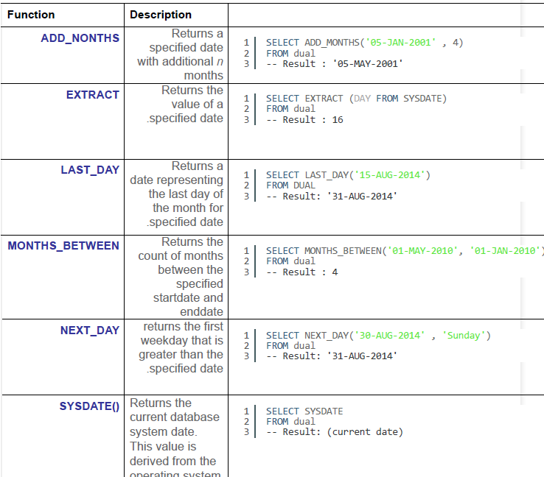
DATE FUNCTIONS

Slide 6
NUMERIC FUNCTIONS

Slide 7
CONVERSION FUNCTIONS

Slide 8
NVL Function

